Slide 1
Artificial Intelligence
Lecture 03
Dr. Ahmed Hassan
Computer Science Department

Slide 2
Books

Slide 3

PowerPoint
http://www.bu.edu.eg/staff/ahmedaboalatah14-courses/14767

Slide 4
Problem-solving
Solving Problems by Searching II

Slide 5
Uniform-cost search
Breadth-first search is optimal because it always expands the shallowest unexpanded node and it use queue.
Instead of expanding the shallowest node, uniform-cost search expands the node n with the lowest path cost g(n).
This is done by storing the frontier as a priority queue ordered by g.
The goal test is applied to a node when it is selected for expansion rather than when it is first generated.
A test is added in case a better path is found to a node currently on the frontier.

Slide 6
Uniform-cost search
S
2
4
A
B
1
3
C
D
3
1
1
2
E
F
G1
2
G2
g(n) | 0
n | S

Slide 7
Uniform-cost search
S
2
4
A
B
1
3
C
D
3
1
1
2
E
F
G1
2
G2
g(n)
n

Slide 8
Uniform-cost search
S
2
4
A
B
1
3
C
D
3
1
1
2
E
F
G1
2
G2
g(n) | 2
n | A

Slide 9
Uniform-cost search
S
2
4
A
B
1
3
C
D
3
1
1
2
E
F
G1
2
G2
g(n) | 2 | 4
n | A | B

Slide 10
Uniform-cost search
S
2
4
A
B
1
3
C
D
3
1
1
2
E
F
G1
2
G2
g(n) | 2 | 4
n | A | B

Slide 11
Uniform-cost search
S
2
4
A
B
1
3
C
D
3
1
1
2
E
F
G1
2
G2
g(n) | 4
n | B

Slide 12
Uniform-cost search
S
2
4
A
B
1
3
C
D
3
1
1
2
E
F
G1
2
G2
g(n) | 3 | 4
n | C | B

Slide 13
Uniform-cost search
S
2
4
A
B
1
3
C
D
3
1
1
2
E
F
G1
2
G2
g(n) | 3 | 4 | 5
n | C | B | D

Slide 14
Uniform-cost search
S
2
4
A
B
1
3
C
D
3
1
1
2
E
F
G1
2
G2
g(n) | 3 | 4 | 5
n | C | B | D

Slide 15
Uniform-cost search
S
2
4
A
B
1
3
C
D
3
1
1
2
E
F
G1
2
G2
g(n) | 4 | 5 | 5
n | B | D | E

Slide 16
Uniform-cost search
S
2
4
A
B
1
3
C
D
3
1
1
2
E
F
G1
2
G2
g(n) | 4 | 5 | 5
n | B | D | E

Slide 17
Uniform-cost search
S
2
4
A
B
1
3
C
D
3
1
1
2
E
F
G1
2
G2
g(n) | 5 | 5
n | D | E

Slide 18
Uniform-cost search
S
2
4
A
B
1
3
C
D
3
1
1
2
E
F
G1
2
G2
g(n) | 5 | 5 | 7
n | D | E | G1

Slide 19
Uniform-cost search
S
2
4
A
B
1
3
C
D
3
1
1
2
E
F
G1
2
G2
g(n) | 5 | 5 |  |  |  |  |  | 7
n | D | E |  |  |  |  |  | G1

Slide 20
Uniform-cost search
S
2
4
A
B
1
3
C
D
3
1
1
2
E
F
G1
2
G2
g(n) | 5 |  |  |  |  |  |  | 7
n | E |  |  |  |  |  |  | G1

Slide 21
Uniform-cost search
S
2
4
A
B
1
3
C
D
3
1
1
2
E
F
G1
2
G2
g(n) | 5 | 6 |  |  |  |  |  | 7
n | E | F |  |  |  |  |  | G1

Slide 22
Uniform-cost search
S
2
4
A
B
1
3
C
D
3
1
1
2
E
F
G1
2
G2
g(n) | 5 | 6 |  |  |  |  |  | 7
n | E | F |  |  |  |  |  | G1

Slide 23
Uniform-cost search
S
2
4
A
B
1
3
C
D
3
1
1
2
E
F
G1
2
G2
g(n) | 5 | 6 |  |  |  |  |  | 6
n | E | F |  |  |  |  |  | G1

Slide 24
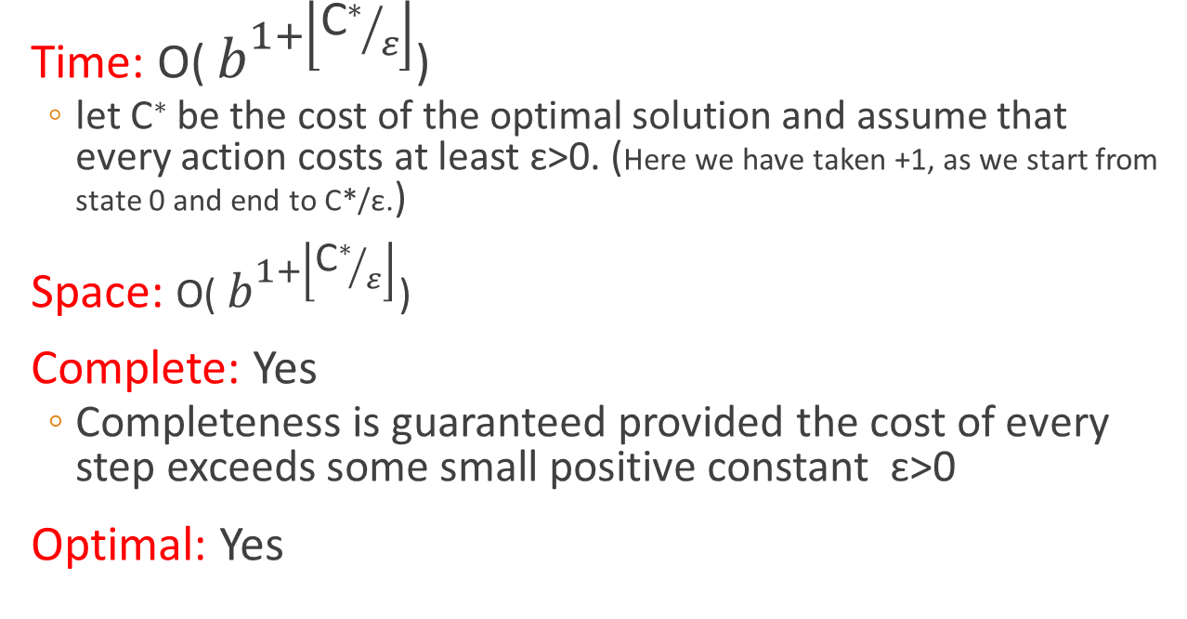
Uniform-cost search
Performance
Time: O( $b^{1+\left\lfloor {\text{C}\text{∗}}/ε\right\rfloor }$)
  let C∗ be the cost of the optimal solution and assume that every action costs at least ɛ>0. (Here we have taken +1, as we start from state 0 and end to C*/ε.)
Space: O( $b^{1+\left\lfloor {\text{C}\text{∗}}/ε\right\rfloor }$)
Complete: Yes
  Completeness is guaranteed provided the cost of every step exceeds some small positive constant ɛ>0
Optimal: Yes

Slide 25
Depth-limited search
The embarrassing failure of depth-first search in infinite state spaces can be alleviated by supplying depth-first search with a predetermined depth limit ℓ.
That is, nodes at depth ℓ are treated as if they have no successors.
The depth limit solves the infinite-path problem.
Unfortunately, it also introduces an additional source of incompleteness if we choose ℓ < d, that is, the shallowest goal is beyond the depth limit. (This is likely when d is unknown.)
Depth-limited search will also be non-optimal if we choose ℓ > d.
Time: O(b^{L})
Space: O(bL)

Slide 26
Depth-limited search

Slide 27
Depth-limited search

Slide 28
Informed Search

Slide 29
INFORMED (HEURISTIC) SEARCH STRATEGIES
Uses problem specific knowledge beyond the definition of the problem itself can find solutions more efficiently than can an uninformed strategy.
  Informed search algorithm contains an array of knowledge such as how far we are from the goal, path cost, how to reach to goal node, etc.
  This knowledge help agents to explore less to the search space and find more efficiently the goal node.
  The informed search algorithm is more useful for large search space.
  Informed search algorithm uses the idea of heuristic, so it is also called Heuristic search.

Slide 30
Informed (Heuristic) Search Strategies
Best-First Search – an algorithm in which a node is selected for expansion based on an evaluation function f(n)
  Traditionally the node with the lowest evaluation function is selected
  Not an accurate name…expanding the best node first would be a straight march to the goal.
  Choose the node that appears to be the best

Slide 31
Informed (Heuristic) Search Strategies
There is a whole family of Best-First Search algorithms with different evaluation functions
  Each has a heuristic function h(n)
h(n) = estimated cost of the cheapest path from node n to a goal node
Example: in route planning the estimate of the cost of the cheapest path might be the straight line distance between two cities

Slide 32
Informed (Heuristic) Search Strategies
g(n) = cost from the initial state to the current state n
h(n) = estimated cost of the cheapest path from node n to a goal node
f(n) = evaluation function to select a node for expansion (usually the lowest cost node)

Slide 33
Informed (Heuristic) Search Strategies
Greedy best-first search
A* Search Algorithm

Slide 34
Greedy Best-First Search
Greedy Best-First search tries to expand the node that is closest to the goal assuming it will lead to a solution quickly
  f(n) = h(n)
Implementation
  expand the “most desirable” node into the fringe queue
  sort the queue in decreasing order of desirability
Example: consider the straight-line distance heuristic h_{SLD}
  Expand the node that appears to be closest to the goal

Slide 35
Greedy Best-First Search
Step 1: Place the starting node into the OPEN list.
Step 2: If the OPEN list is empty, Stop and return failure.
Step 3: Remove the node n, from the OPEN list which has the lowest value of h(n), and places it in the CLOSED list.
Step 4: Expand the node n, and generate the successors of node n.
Step 5: Check each successor of node n, and find whether any node is a goal node or not. If any successor node is goal node, then return success and terminate the search, else proceed to Step 6.
Step 6: For each successor node, algorithm checks for evaluation function f(n), and then check if the node has been in either OPEN or CLOSED list. If the node has not been in both list, then add it to the OPEN list.
Step 7: Return to Step 2.

Slide 36
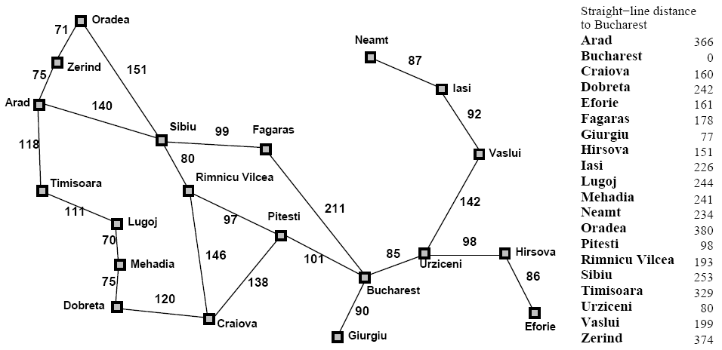
Greedy Best-First Search

Slide 37
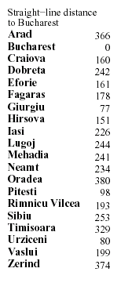
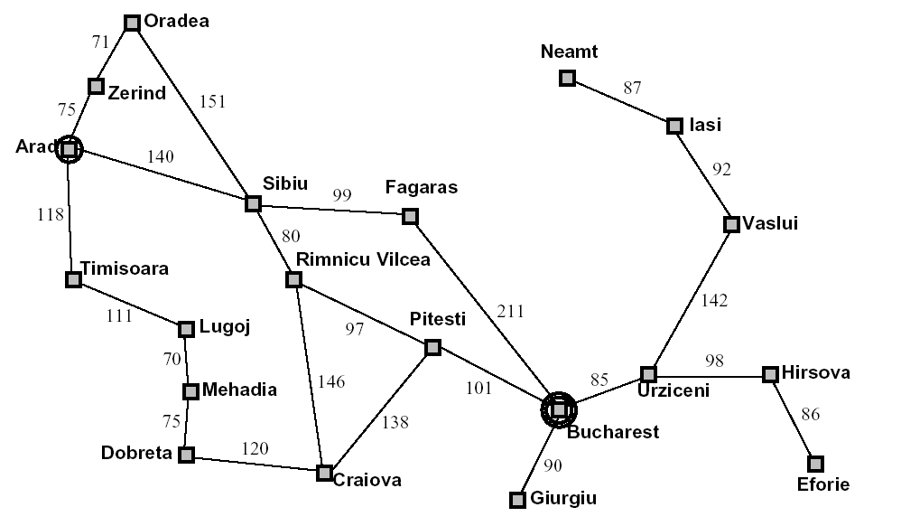
374
253
366
329
Notes:
This shows the difference between straight line distances and other distances…

Slide 38
Greedy Best-First Search
h_{SLD}(In(Arad)) = 366
Notice that the values of h_{SLD} cannot be computed from the problem itself
It takes some experience to know that h_{SLD} is correlated with actual road distances
  Therefore a useful heuristic

Slide 39

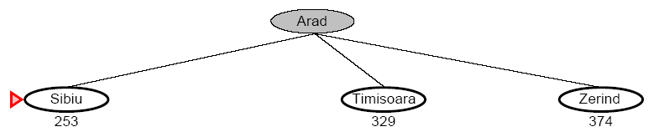
Greedy Best-First Search

Slide 40
374
253
366
329
Notes:
This shows the difference between straight line distances and other distances…

Slide 41
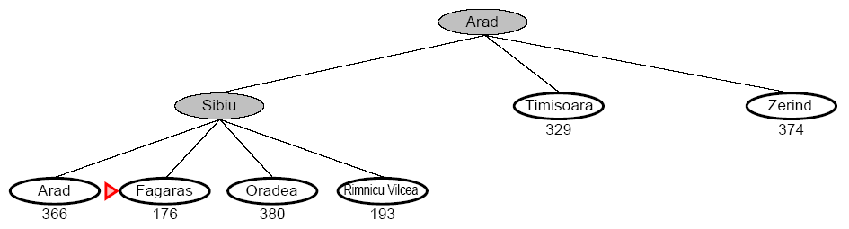
Greedy Best-First Search

Slide 42
374
253
366
329
Notes:
This shows the difference between straight line distances and other distances…

Slide 43
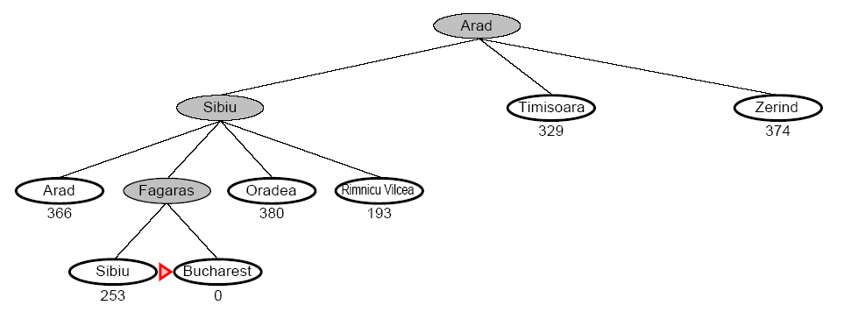
Greedy Best-First Search

Slide 44
374
253
366
329
Notes:
This shows the difference between straight line distances and other distances…

Slide 45
Greedy Best-First Search
Complete
  No, GBFS can get stuck in loops (e.g. bouncing back and forth between cities)
Time
  O(b^{m}) but a good heuristic can have dramatic improvement
Space
  O(b^{m}) – keeps all the nodes in memory
Optimal
  No!

Slide 46
A Quick Review - Again
g(n) = cost from the initial state to the current state n
h(n) = estimated cost of the cheapest path from node n to a goal node
f(n) = evaluation function to select a node for expansion (usually the lowest cost node)

Slide 47
A* Search

Slide 48
A* Search
A* Search algorithm is one of the best and popular technique used in path-finding and graph traversals. A* Search evaluate a search space using a heuristic function.

Slide 49
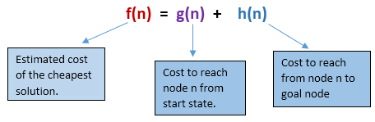
A* Search
A* (A star) is the most widely known form of Best-First search
  It evaluates nodes by combining g(n) and h(n)
  f(n) = g(n) + h(n)
  Where
    g(n) = is the cost of the path from the start to n.
    h(n) = estimated cost to goal from n
    f(n) = estimated total cost of path through n

Slide 51

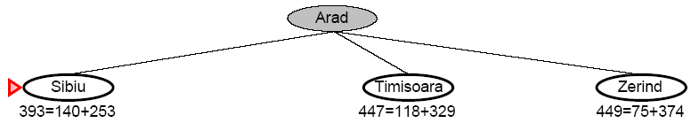
A* Search

Slide 52
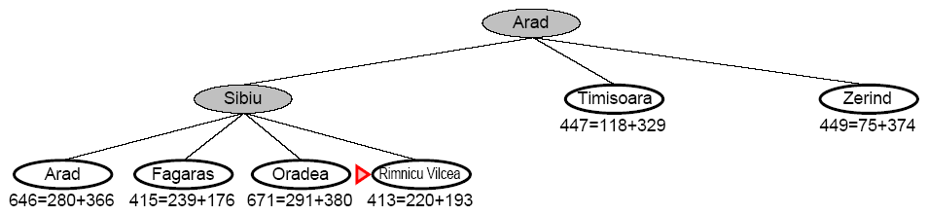
A* Search

Slide 53
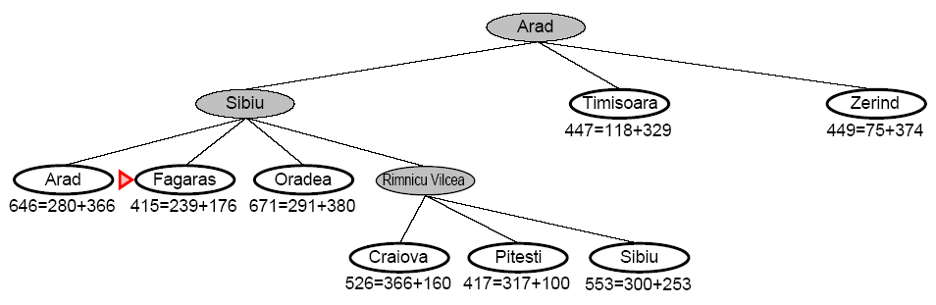
A* Search

Slide 54
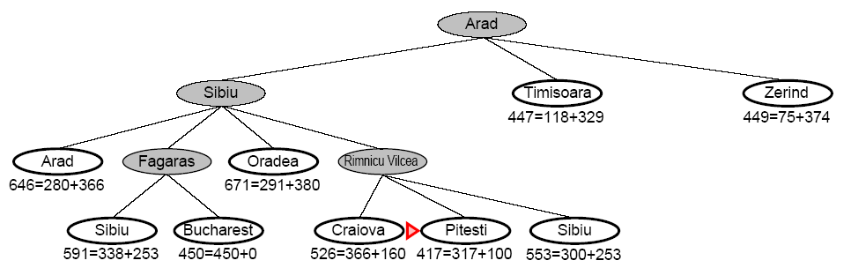
A* Search

Slide 55
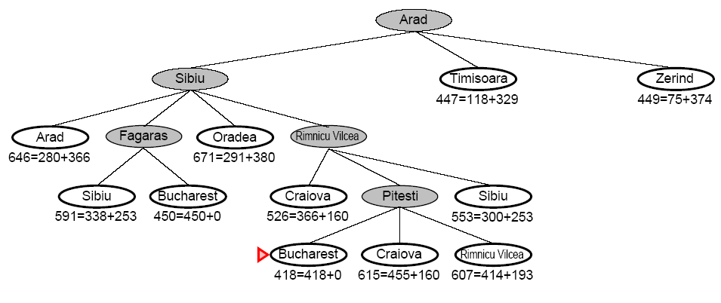
A* Search

Slide 56
Notes:
This shows the difference between straight line distances and other distances…

Slide 57
A* Search
When h(n) = actual cost to goal
  Only nodes in the correct path are expanded
  Optimal solution is found
When h(n) < actual cost to goal
  Additional nodes are expanded
  Optimal solution is found
When h(n) > actual cost to goal
  Optimal solution can be overlooked

Slide 58
A* Search
Complete
  Yes, unless there are infinitely many nodes with f <= f(G)
Time
  Exponential in [relative error of h x length of soln]
  The better the heuristic, the better the time
    Best case h is perfect, O(d)
    Worst case h = 0, O(b^{d}) same as BFS
Space
  Keeps all nodes in memory and save in case of repetition
  This is O(b^{d}) or worse
  A* usually runs out of space before it runs out of time
Optimal
  Yes, cannot expand f_{i+1} unless f_{i} is finished

Slide 59











A
A* Search example
7
4
3
B
C
7
4
D
11
2
7
5
3
F
H
5
3
E
6
2
2
4
I
7
4
2
J
3
4
G
6
0

Slide 60
A
A* Search example
7
4
3
f(n)=g(n)+h(n)
B
C
7
4
D
11
2
7
5
3
F
H
5
3
E
6
2
2
4
I
7
4
2
J
3
4
G
6
0

Slide 61
A
A* Search example
7
4
3
f(n)=g(n)+h(n)
B
C
7
4
D
11
2
7
f(B)=4+7=11
f(C)=3+7=10
5
3
F
H
5
3
E
6
2
2
4
I
7
4
2
J
3
4
G
6
0

Slide 62
A
A* Search example
7
4
3
f(n)=g(n)+h(n)
B
C
7
4
D
11
2
7
f(F)=5+5=10
f(H)=10+3=13
5
3
F
H
5
3
E
6
2
2
4
I
7
4
2
J
3
4
G
6
0

Slide 63
A
A* Search example
7
4
3
f(n)=g(n)+h(n)
B
C
7
4
D
11
2
7
f(I)=7+2=9
5
3
F
H
5
3
E
6
2
2
4
I
7
4
2
J
3
4
G
6
0

Slide 64
A
A* Search example
7
4
3
f(n)=g(n)+h(n)
B
C
7
4
D
11
2
7
f(H)=9+3=12
f(G)=10+0=10
f(J)=11+4=15
5
3
F
H
5
3
E
6
2
2
4
I
7
4
2
J
3
4
G
6
0

Slide 65
A
A* Search example
7
4
3
B
C
7
4
D
11
2
7
5
3
F
H
f(n)=g(n)+h(n)
5
3
E
Goal
6
2
2
4
I
7
4
2
J
3
4
G
6
0

Slide 66
Best-First Search
Remember: Uniform cost search
  F(n) = g(n)
Best-first search:
  F(n) = h(n)
Later, a-star search:
  F(n) = g(n) + h(n)

Slide 67
Problem
Solve the following graph problem (avoid loop problem) to reach any goals G1,G2 using:
Depth First Search
Breadth First Search
Uniform Cost Search
Greedy Best First Search
A* Search

Slide 68











Problem
6
6
A
5
B
6
C
6
3
3
2
3
2
D
E
3
F
6
2
4
6
G1
6
H
7
G1
7
G2
0
0

Slide 69
6
A
B
6
C
3
3
2
3
2
D
E
F
4
6
G1
6
H
7
G1
G2

Slide 70

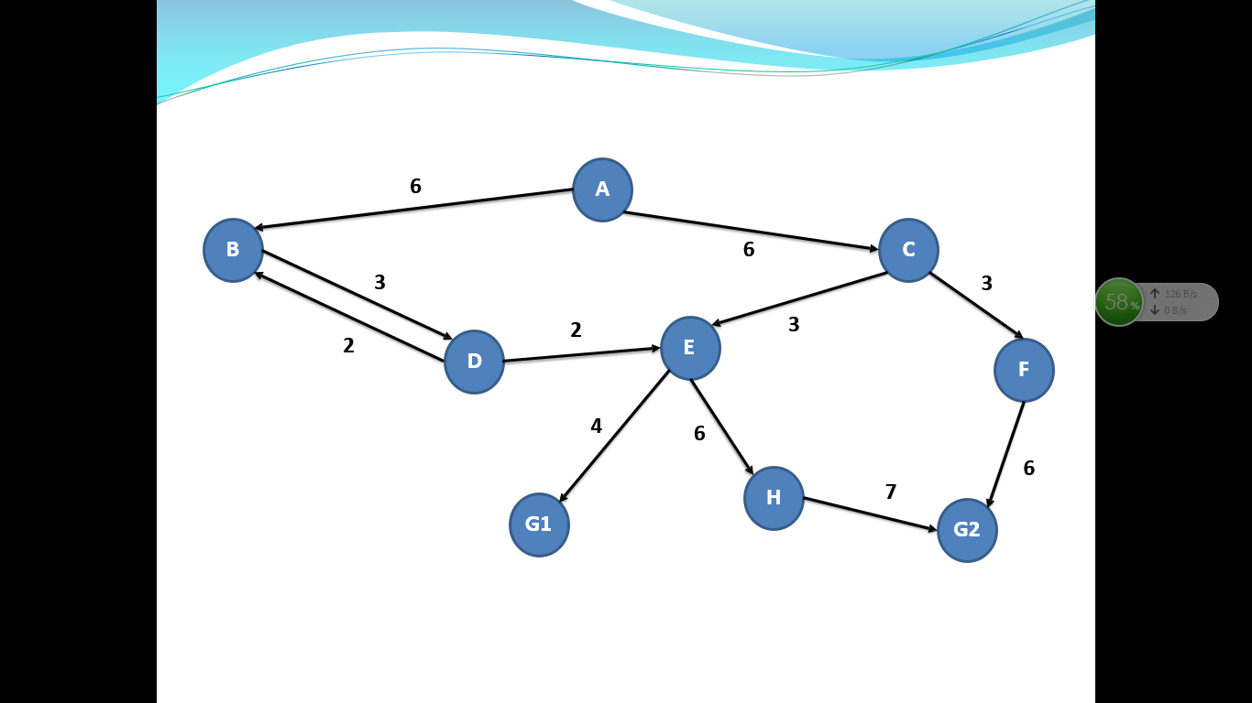

Depth First Search
C
A
B

Slide 71

Depth First Search
C
A
D
G1
B
D

Slide 72


Depth First Search
C
A
D
G1
E
B
D
B

Slide 73
Depth First Search
C
A
D
G1
E
G1
B
D
B
D

Slide 74
Depth First Search
C
A
D
G1
E
G1
Loop Problem
B
D
B
D

Slide 75
Depth First Search
C
Visited List:
A
A
D
B

Slide 76
Depth First Search
C
Visited List:
A,B
A
D
G1
B
D

Slide 77
Depth First Search
C
Visited List:
A,B,D
A
D
G1
E
B
D
B

Slide 78
Depth First Search
C
A
D
G1
E
B
D
B
Visited List:
A,B,D

Slide 79



Depth First Search
C
Visited List:
A,B,D,E
H
A
D
G1
E
G1
B
D
B

Slide 80


Depth First Search
C
Visited List:
A,B,D,E
H
A
D
G1
E
G1
B
D
B

Slide 81

Depth First Search
Path= A-> B->D->E->G1
C
Visited List:
A,B,D,E
H
A
D
G1
E
G1
B
D
B

Slide 82
Breadth First Search
6
A
B
6
C
3
3
2
3
2
D
E
F
4
6
G1
6
H
7
G1
G2

Slide 83
Breadth First Search
C
A
D
B

Slide 84

Breadth First Search
C
A
D
B
G1
D

Slide 85
Breadth First Search
C
A
D
E
B
B
G1
D

Slide 86


Breadth First Search
F
C
E
A
D
E
B
B
G1
D

Slide 87


Breadth First Search
F
C
E
E
A
D
E
B
B
G1
E
D
B

Slide 88
Breadth First Search
F
C
E
E
H
A
D
E
E
G1
B
D
B
G1
E
D
B

Slide 89
Breadth First Search
F
A
E
H
C
E
G1
H
A
D
E
E
B
D
B
G1
E
D
B

Slide 90
Breadth First Search
F
A
G2
E
H
C
E
G1
H
A
D
E
E
B
D
B
G1
E
D
B

Slide 91
Breadth First Search
Path= A-> C->E->G1
F
A
G2
E
H
C
E
G1
H
A
D
E
G1
E
B
D
B
G1
E
D
B

Slide 92
Uniform Cost Search
6
A
B
6
C
3
3
2
3
2
D
E
F
4
6
G1
6
H
7
G1
G2

Slide 93
Uniform Cost Search
C
Visited List:
A
6
A
6
B
B

Slide 94
Uniform Cost Search
C
Visited List:
A,B
6
A
C
6
B
G1
9
D

Slide 95

Uniform Cost Search
9
F
C
Visited List:
A,B,C
9
E
6
A
C
6
B
G1
9
D

Slide 96
Uniform Cost Search
9
F
C
Visited List:
A,B,C,D
9
E
6
A
C
6
B
G1
11
E
9
D
11
B

Slide 97
Uniform Cost Search
9
F
C
15
H
Visited List:
A,B,C,D,E
9
E
6
13
G1
A
C
6
B
G1
11
E
9
D
11
B

Slide 98
Uniform Cost Search
15
G2
9
F
C
15
H
Visited List:
A,B,C,D,E,F
9
E
6
13
G1
A
C
6
B
G1
11
E
9
D
11
B

Slide 99
Uniform Cost Search
15
G2
9
F
C
15
H
Visited List:
A,B,C,D,E,F
9
E
6
13
G1
A
C
6
B
G1
11
E
9
D
11
B

Slide 100
Uniform Cost Search
15
G2
9
Path= A-> C->E->G1
F
C
15
H
Visited List:
A,B,C,D,E,F, G1
9
E
6
13
G1
A
C
6
B
G1
11
E
9
D
11
B

Slide 101
Best first Search
9
6
A
5
B
6
C
6
3
3
2
3
2
D
E
3
F
6
2
4
6
G1
6
H
7
G1
7
G2
0
0

Slide 102
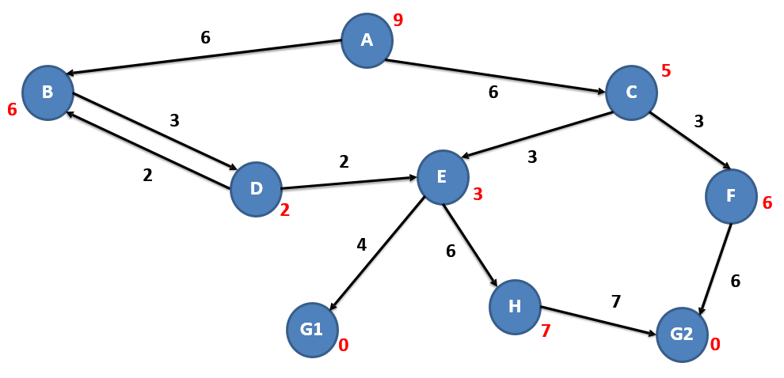
Best first Search
C
5
A
B
6

Slide 103
Best first Search
F
6
C
5
E
3
A
C
B
6
D

Slide 104
Best first Search
F
6
C
5
E
3
A
C
B
6
G1

Slide 105
Best first Search
F
6
C
5
H
7
E
3
G1
0
A
C
B
6
G1

Slide 106
Best first Search
F
6
Path=A->C->E->G1
C
5
H
7
E
3
G1
0
A
C
B
6
G1

Slide 107
A* Search
9
6
A
5
B
6
C
6
3
3
2
3
2
D
E
3
F
6
2
4
6
G1
6
H
7
G1
7
G2
0
0

Slide 108
A* Search
C
5
11
Visited List:
A
6
A
6
B
B
6
12

Slide 109
A* Search
3
F
6
15
C
5
11
Visited List:
A,C
3
E
3
12
6
A
C
6
B
6
12
G1
D

Slide 110
A* Search
3
F
6
15
C
5
11
Visited List:
A,C,B
3
E
3
12
6
A
C
6
B
6
12
G1
3
D
2
11

Slide 111
A* Search
3
F
6
15
C
5
11
Visited List:
A,C,B,D
3
E
3
12
6
A
C
6
G1
E
3
14
B
6
12
2
D
2
11
3
B
6
17
2

Slide 112
A* Search
3
F
6
15
C
5
11
Visited List:
A,C,B,D,E,G1
6
H
7
22
3
E
3
12
6
4
G1
0
13
A
C
6
G1
E
3
14
B
6
12
2
D
2
11
3
B
6
17
2

Slide 113
A* Search
3
F
6
15
Path= A-> C->E->G1
C
5
11
Visited List:
A,C,B,D,E,G1
6
H
7
22
3
E
3
12
6
4
G1
0
13
A
C
6
G1
E
3
14
B
6
12
2
D
2
11
3
B
6
17
2

Slide 114


Slide 115
?

